Slide 1
Safety & Sanitation
8088

Slide 2
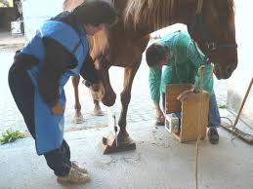
What we will cover
OSHA
Types of Safety Hazards
  Physical hazards
  Chemical hazards
  Biological hazards
  Zoonotic hazards
Safety Signs and Equipment Handling
  Restraint of Animals
  Drug Use and Safety
Sanitation
Types of sanitation
  Commonly used chemicals
  Methods of sanitation

Slide 3
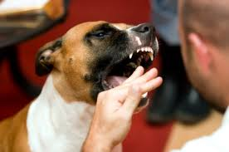
Why?
People who work with animals are faced with potentially hazardous situations on a daily basis.
Other dangers
  hazardous chemicals
  animal wastes
  x-rays
Everyone should be aware and safe!

Slide 4

OSHA
Occupational Health and Safety Act in 1970 and the Occupational Health and Safety Administration (OSHA) was created to
  “assure safe and healthful working conditions for working men and women”
Government agency, in the U.S. Department of Labor, which regulates and monitors employee safety in the workplace.
OSHA developed a set of guidelines called the Hazard Communication Standard (HCS).
  Compliance with these guidelines is mandatory.
  “Right to Know” when they are in a situation that could be a health hazard.
  The HCS places responsibility on the companies that manufacture hazardous materials and on the employer.

Slide 5
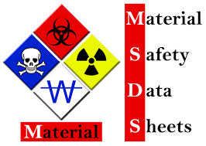
MSDS
Manufacturers are required to label their chemicals clearly and apply warnings if the chemical is flammable, corrosive, or poisonous.
They must also provide an MSDS (Material Safety Data Sheet) for every chemical.
The MSDS must include the following 8 sections:
  Manufacturer Information
  Hazard Ingredients/ Identity Information
  Physical/Chemical Characteristics
  Fire and Explosion Hazard Data
  Reactivity Data
  Health Hazard Data
  Precautions for Safe Handling and Use
  Control Measures
Employers must devise a written training program for their employees.
  Must educate employees on the hazards associated with the use of specific chemicals, the use of protective clothing, and how to use the MSDS.
  All businesses are required to comply with OSHA safety standards and laws and are subject to large fines if they fail to comply.

Slide 6
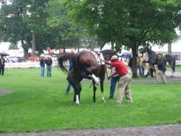
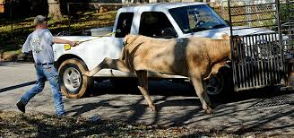
Physical Hazards
Physical injuries from animals are the most common type.
  Frightened or nervous animals may bite, kick, and scratch when being handled.
  More dangerous when working with farm animals due to their size.
  Cats also present a specific hazard, cat scratch fever.
Other physical injuries include:
  Back injuries due to improper lifting
  Falls on wet floors
  Exposure to x-rays
To prevent injury proper clothing and footwear should always be worn when working with animals.
Learning animal behavior and the correct handling and restraint techniques can help prevent injuries.

Slide 7
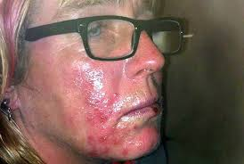
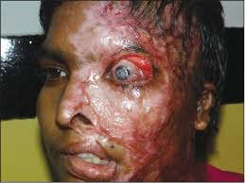
Chemical Hazards
Many hazardous chemicals are routinely used in the veterinary hospital.
  Drugs, cleaning agents, insecticides, and anesthetic gases.
  Can cause damage to the skin and eyes and to the lungs if they are inhaled.
  Some chemicals may also cause abortion and/or fetal abnormalities if absorbed into the bloodstream.
Knowing the proper use for each substance and using safety measures is the best way to protect against a chemical accident.
Never use chemicals for other than their intended use and never mix chemicals together.

Slide 8
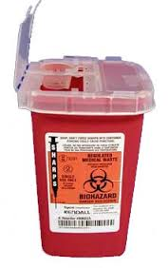
Biological Hazards
Biohazards include living tissue and organisms, blood, urine, live vaccines, and any medical waste that has come in contact with living tissue such as: blood or urine soaked blankets and bandage materials, needles and scalpels (commonly called “sharps”).
They can spread disease from one animal to another or from animals to humans.
The federal Medical Waste Tracking Act of 1988 regulates the disposal of medical wastes and biohazards.
Environmental Protection Agency (EPA) determines what regulations must be followed when disposing of biohazards.
All “sharps” must be disposed of in red, sealed containers called sharps containers.
  All sharps containers are labeled with the biohazard symbol.
Medical wastes must be sterilized, incinerated, or chemically disinfected before they are disposed of.
Gloves and protective clothing should be worn when handling biohazards.

Slide 9
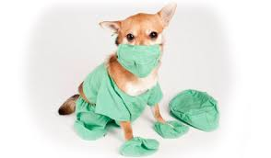
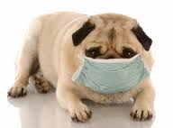
Zoonotic Hazards
A zoonotic hazard is any disease that can be passed from animals to humans. Viruses, bacteria, parasites, and fungi can cause zoonotic disease.
Viral Diseases
  Rabies (Hydrophobia)
  Sleeping sickness (Encephalitis)
Bacterial Diseases
  Cat Scratch Fever
  Leptospirosis o Salmonellosis o Brucellosis
  Anthrax
  Tuberculosis
Parasitic Diseases
  Sarcoptic mange
  Toxoplasmosis
  Visceral Larva Migrans (Toxocariasis)
  Creeping Eruption (Ancylostomiasis)
Fungal Diseases
  Ringworm
There are several ways to prevent the spread of these diseases including:
  Vaccination of animals and humans
  Proper waste disposal
  Isolating infected animals
  Proper handling of infected animals
  Proper sanitation of hospital
  Hand washing
  Wearing protective clothing

Slide 10
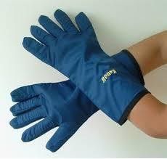
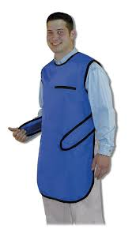
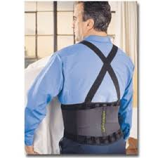
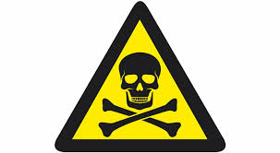

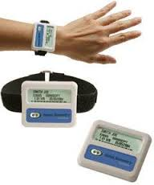

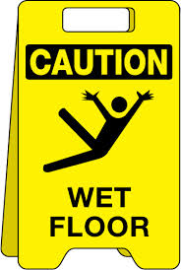
Safety signs & equipment
In order to maintain a safe working environment OSHA requires businesses to use specific safety signs and equipment.
Signs
  Danger
  Radioactive
  Biohazard
  Wet Floor
Equipment
  Lead gloves
  Lead apron
  Back brace
  Dosimeter

Slide 11
Handling & Restraint
Many injuries in the veterinary field are animal related.
Handlers often get bitten or kicked while attempting to treat or examine an injured animal.
Knowing and using the proper handling and restraint methods used for each species of animal will drastically reduce the number of animal related injuries.
Handling and restraint methods should be practiced on healthy, docile animals so that the proper techniques can be learned before handling injured or frightened animals.

Slide 12
Animal Restraints
Sternal Recumbency
Lateral Recumbency
The Stretch

Slide 13
Drug use and Safety
In 1970 the Comprehensive Drug Abuse Prevention and Control Act was passed into law.
Title II of this law, the Controlled Substances Act, is the legal foundation of narcotics enforcement in the United States.
The Controlled Substance Act regulates the manufacture and distribution of drugs, and places all drugs into one of five schedules.
Drugs that fall into these five schedules must be kept in a locked container that only approved people have access to (veterinarians and vet techs).
A daily log must be kept to track the use of each drug so that they are not used improperly.

Slide 14
SCHEDULE I
A: Drug has no current accepted medical use.
B: Drug has a high potential for abuse.
Class examples: Heroin, Methaqualone, LSD, Peyote, Psilocybin, Marijuana, Hashish, Hash Oil, and various amphetamine variants

Slide 15
SCHEDULE II
A: Drug has current accepted medical use.
B: Drug has high potential for abuse.
Class examples: Dilaudid, Demerol, Methadone, Cocaine, PCP, Morphine and certain cannibis, amphetamine, and barbiturates types

Slide 16
SCHEDULE III
A: Drug has current accepted medical use.
B: Drug has medium potential for abuse.
Class examples: Opium, Vicodan, Tylenol w/codeine and other narcotic, amphetamine, and barbiturate types

Slide 17
SCHEDULE IV
A: Drug has current accepted medical use.
B: Drug has low potential for abuse.
Class Examples: Darvocet, Xanax, Valium, Halcyon, Ambien, Ativan, and other barbiturate types

Slide 18
SCHEDULE V
A: Drug has accepted medical use.
B: Drug has lowest potential for abuse.
Class examples: Lomotil, Phenergan, and liquid suspensions.

Slide 19
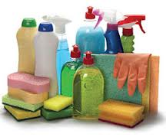
Sanitation
Sanitation is the process of keeping something free of any elements that would endanger health. There are many methods used to keep the hospital environment and the animals and people within it sanitary

Slide 20
Types of sanitation
Cleaning –physically removing all visible signs of dirt and organic matter such as feces, blood, hair, etc.
Disinfecting –destroying most microorganisms on nonliving things by physical or chemical means.
Sterilizing – destroying all microorganisms and viruses on an object using chemicals and/or heat.
Antiseptics – solutions that destroy microorganisms or inhibit their growth on living tissue.

Slide 21
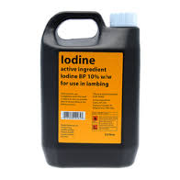
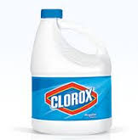
Commonly used chemicals
Commonly Used Chemicals
Alcohols – (ethyl alcohol, isopropyl alcohol, ethanol)
  Effective against gram positive and negative bacteria
  Usually diluted to 60-70%
  Irritating to tissues
  Used as a solvent for disinfectants and antiseptics
Aldehydes – (gluteraldehyde, formaldehyde)
  Effective against gram positive and negative bacteria, fungi, and most viruses
  Irritating and toxic to tissues
Chlorine – (bleach)
  Effective against gram positive and negative bacteria, fungi, and most viruses
  Cheapest, most effective chemical disinfectant
  Irritating and toxic to tissues
Iodine and Iodophors – (Betadine)
  Effective against gram positive and negative bacteria, and fungi
  Usually used in solution with water or alcohol
  Iodophors = iodine mixed with detergent to use as a surgical scrub
  Stains and irritates tissues
Quaternary ammonias – (Centrimide, Quatsyl-D)
  Effective against gram positive bacteria and some gram negative bacteria, some fungi, and some viruses
  Deodorizes

Slide 22
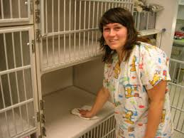
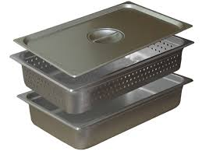
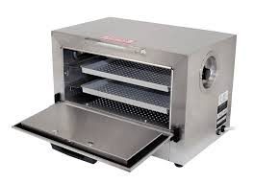
Methods of Sanitation
There are many methods of sanitation commonly used in the veterinary hospital. The method chosen depends on the results that are desired and the cost.
Physical Cleaning – using a chemical with a mop or sponge, i.e. scrubbing a patient for surgery or mopping a kennel floor.
Cold Sterilization – soaking items in a chemical disinfectant until they are used. This method is used for items too large to be autoclaved.
Dry Heat – incinerating an object or exposing it to flame, i.e. burning animal carcasses or infected tissue, or passing a microbiology “loop” through open flame.

Slide 23
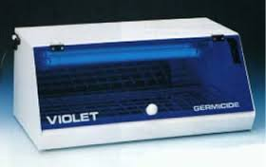
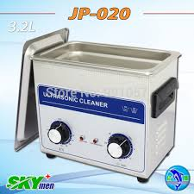
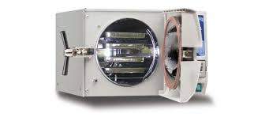
Methods of Sanitation
Radiation – using ultraviolet or gamma rays. UV rays are used to sterilize rooms; gamma rays sterilize rubber, plastic, gloves, and suture material. This method is expensive and dangerous to use.
Filtration – removing particles from the air using a physical barrier, i.e. using facemasks, gloves, and gowns or a ventilations system.
Ultrasound – passing high frequency sound waves through a solution to create a vibration that scrubs an object to remove debris. Ultrasound is commonly used in veterinary hospitals as a method of cleaning instruments.
Autoclave – a sealed chamber in which objects are exposed to heat and steam under pressure. Autoclaves are commonly used to sterilize items used in surgery.

