Slide 1
Manufacturing the mini grubbing hoe
Making a Jig for Production

Slide 3
Making a prototype
Making a prototype will help identify problems that can be solved using jigs and templates.

Slide 4
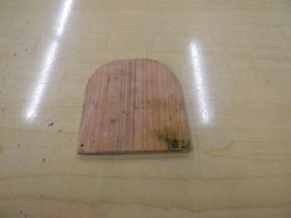
Make a template
Refine your design and cut a template for the hoe end of the mini grubbing hoe

Slide 5
Make each piece uniform
Use the template to draw each piece so they will be cute to a uniform size and shape

Slide 6
Create a jig
Use your template to create a jig to bend your fork ends.
Note: this jig will need to be smaller than the template if you want the same size fork as the hoe end.

Slide 7
Calculate fork length
Calculate how long to cut the pieces to make the ends of the fork even once they are bent.

Slide 8
Ready for a vise
Attach a flat bar to the bottom of your jig.
This allows you to hold the jig in a vise while you are bending or welding.

Slide 9
Prepare the forks
Use the grinder to sharpen both ends of the fork piece.
Heat the fork piece with the oxy fuel torch and bend the fork.

Slide 10
Making a fork jig
Use a fork bend to make the fork end jig.
Weld small pieces of bar stock to hold fork in place.

Slide 11
Jig for the center fork
Add a third piece to align the center fork for welding.

Slide 12
Adding a stop to the jig
Add a forth piece to act as a stop for the fork and to center the square tubing for welding.

Slide 13
Putting the pieces together
Using the jig to help hold the pieces then tack weld your pieces together.

Slide 14
Check for fit
Remove the tool from the jig to check for fit.
Make adjustments as needed.
Weld your pieces together on both sides.

Slide 15
Finishing
Clean with a flap disk or die grinder.
Prime and paint

Slide 16
Fitting the handle
Cut handle a little longer than the tubing used.
Use handsaw to make stopping cuts.
Use a knife or chisel to spit the chips off, so the handle will fit into the tubing.

Slide 17
Finishing the handle
Saw a slit into the end of the handle and cut a wedge to drive in the slit.
Fit the handle just as you would put any handle on.
Coat handle with a clear finish.

